Slide 1
Machine learning in ufc prediction
Ilan Barr
Advisor: Cynthia MA
May 1, 2024
Notes:
The ufc stands for Ultimate Fighting Championship

Slide 2
overview
Introduction
Problem Formulation
Methodology
Data Collection
Feature Engineering
Modeling
Results
Conclusion

Slide 3
Introduction

Slide 4
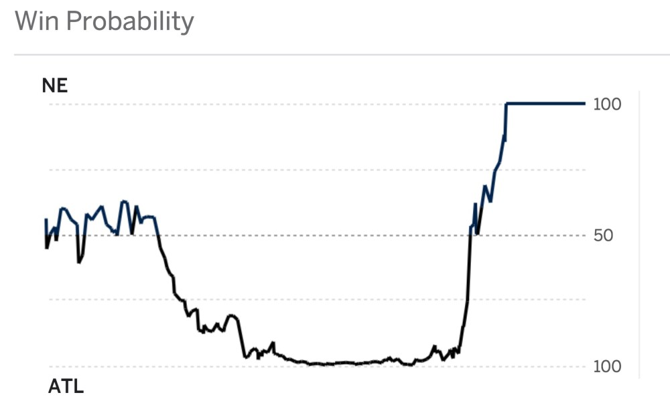
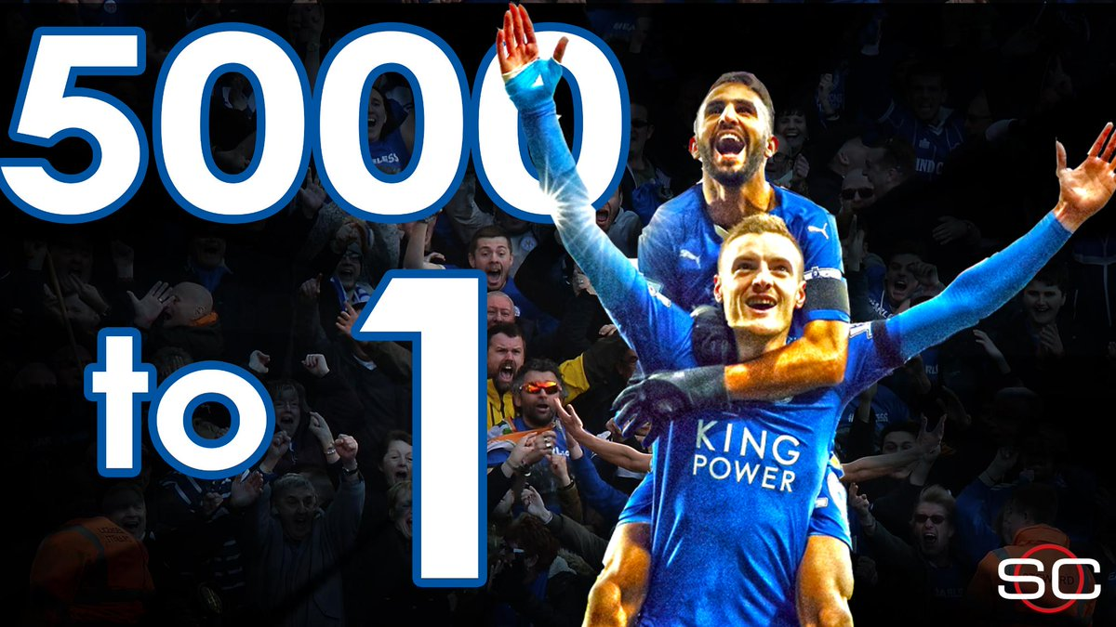
Unpredictability in sports
Notes:
Unpredictable
-For sports fans, what makes it so much fun, is nobody knows who will win the game beforehand.
-While upsets are rare, they happen. And are possible
2016 superbowl ATL was 99.6% to win the game according to ESPN’s
Leicester City wins premier league in 2015/16. pre season 5000-1 odds

Slide 5
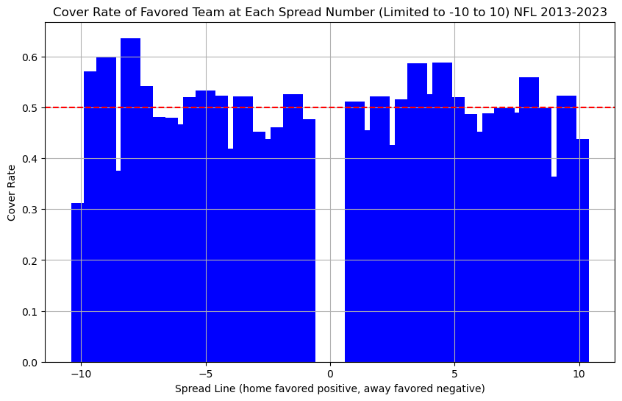
Sports betting: Embracing the unpredictability
$235 B industry
Factors influencing betting odds:
Sportsbooks’ Models
Price Discovery
Wisdom of the Crowd
Prediction Accuracy is Everything
The favorite covered the spread 50.18% of the time.
Notes:
The spread bet is a way to level the playing field between two teams.
If one team is much better than the other, the spread is essentially a handicap which intends to make it a 50/50 of which team will cover the spread.
If one team is favored by 2.5 betting on their means they need to win by more than 2.5 points, or the other team would cover.

Slide 6
Sports betting math: a simple example
Correctly Priced
Mispriced
Team | Betting Odds | Breakeven Probability | True win Percent
Team 1 | -110 | 52.38% | 50%
Team 2 | -110 | 52.38% | 50%
Team | Betting Odds | Breakeven Probability | True win Percent
Team 1 | -110 | 52.38% | 60%
Team 2 | -110 | 52.38% | 40%
Expected Value betting $110 on either team:
$$−0.5∗110+0.5∗100=−\$5$$
$$−\frac{5}{110}=−4.5\%$$
Expected Value betting $110 on either team:
$$−0.4∗110+0.6∗100=\$16$$
$$\frac{16}{110}=14.5\%$$

Slide 7
Problem Formulation

Slide 8
Beat sportsbooks in ufc prediction using machine learning
GOAL: prove “The house always wins” WRONG
Create ML models to predict fight outcomes more successfully than sportsbooks.
Strategy:
Two Layer Hierarchical Model Structure:
1st Layer: Expected Rounds¹
2nd Layer: Full Fight Prediction

Slide 9
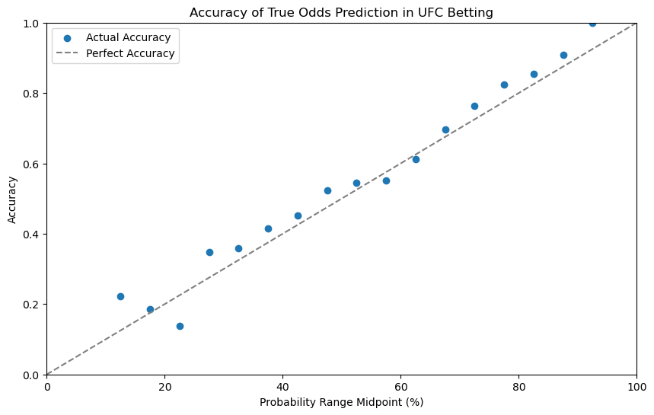
Why ufc
Relatively New
Founded 1993
Not much quantitative analysis done
Less efficient Betting Markets than other sports
Opportunity to learn about a new sport
Notes:
As someone who is a pretty big sports fan, I would call myself a casual UFC fan at best, and this project was a great opportunity to learn the ins and outs of a new sport.
NFL founded 1920, MLB founded 1903, NBA founded 1946
Implied probability of the betting odds vs. the proportion of times those won.

Slide 10
Methodology

Slide 11
Data collection
3 sources
Download
Kaggle (Dan Mcinerney)
Scraping:
UFC Stats
MMA Decisions (Mixed Martial Arts)

Slide 12
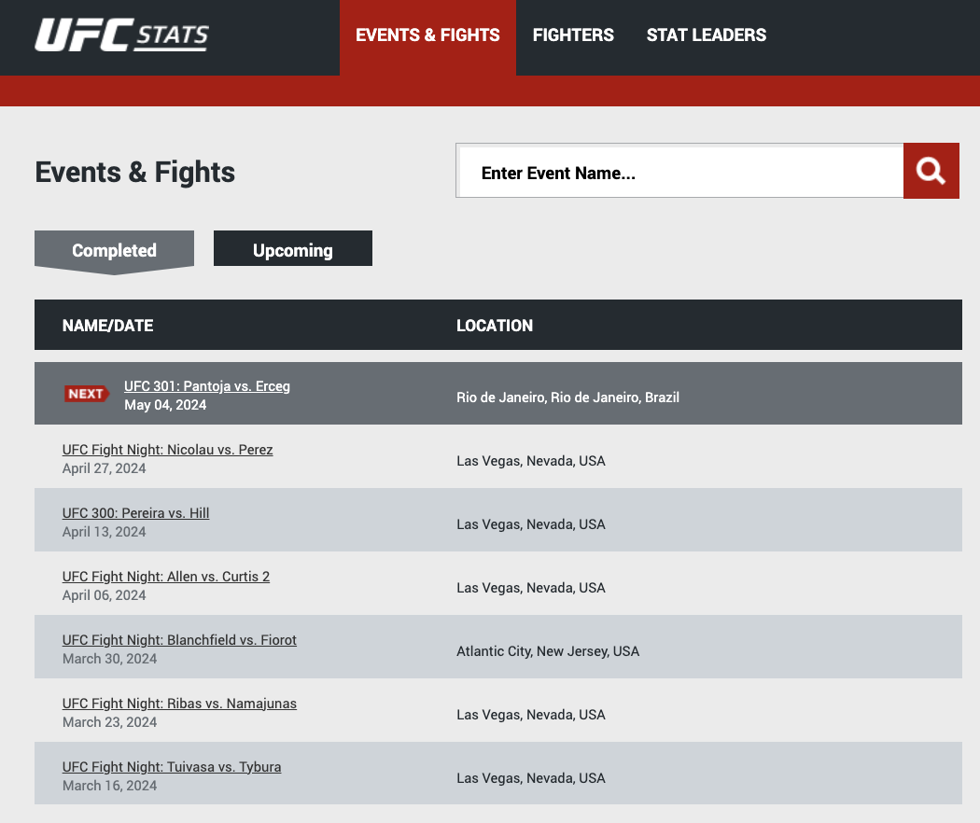
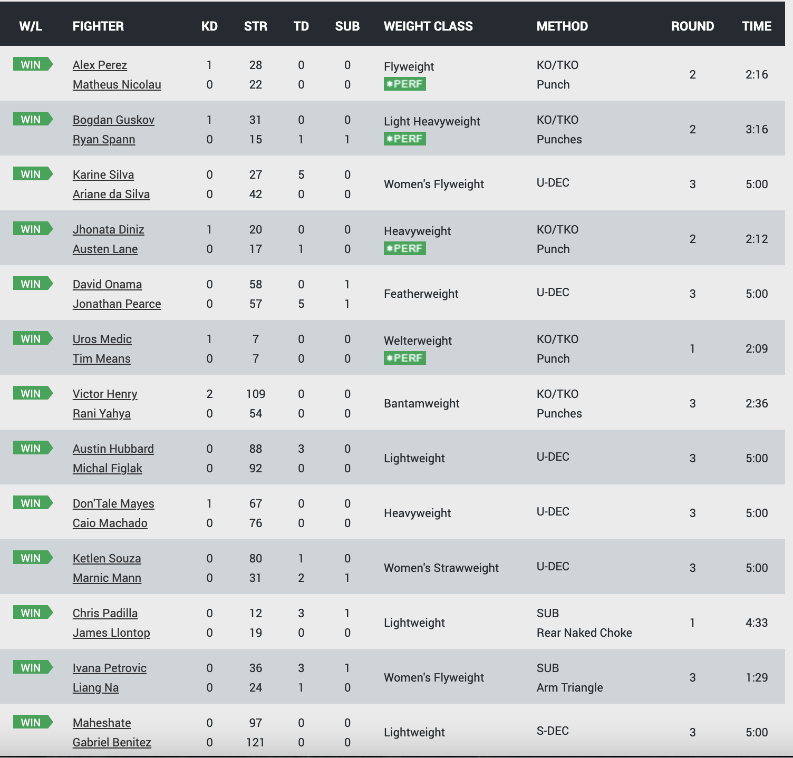
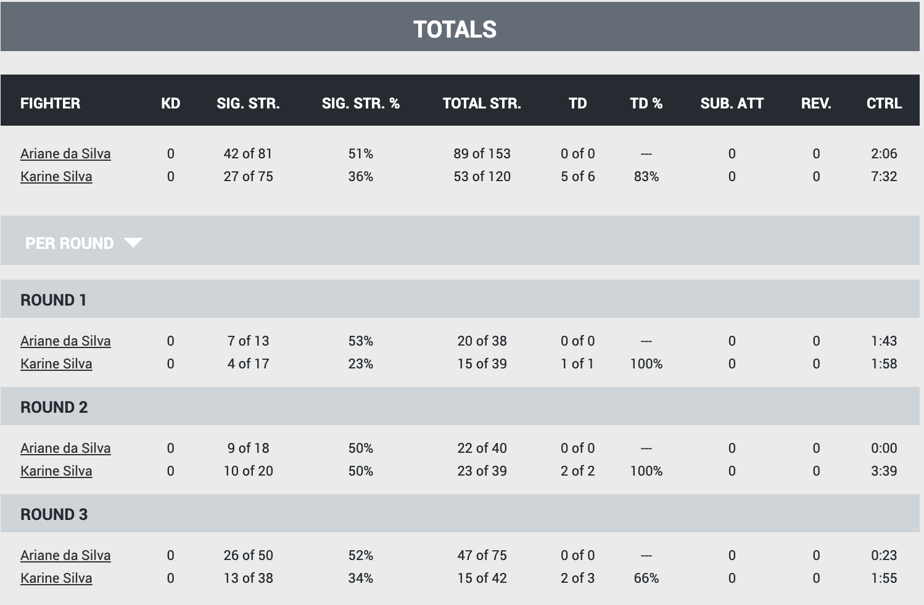
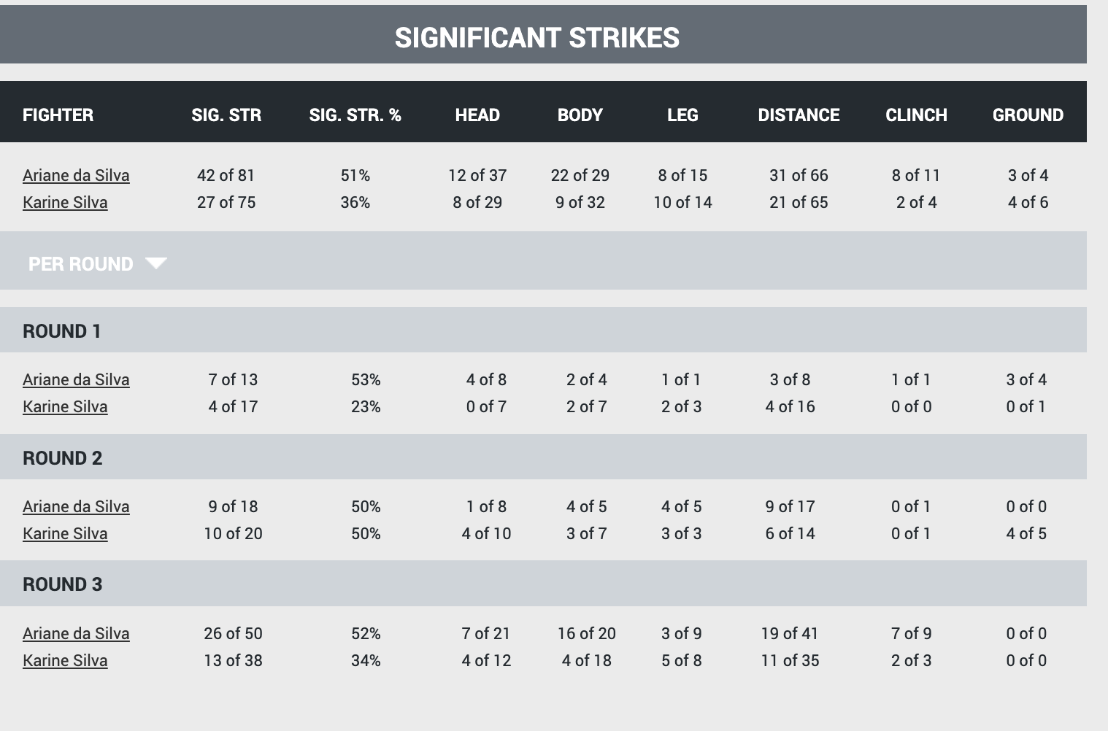
Scraping Methods
Example from UFC Stats:
1. Scrape All Event URLs
2. Scrape All Fight URLs
3. Scrape Fight Information
Same Approach with MMA Decisions

Slide 13
Dataset breakdown
Scraping:
MMA Decisions:
2621 Fights/rows
36 Features
UFC Stats:
34666 Rows – 2 per round
21 Features
Download
Kaggle:
14130 Rows – 2 per fight
51 Features

Slide 14
Feature engineering / Data Manipulation
Combined Data from judge scores dataset (MMA Decisions) and round by round fight stats (UFCStats)
Create ”Round Winner” from judge scorecards
Processing from text to numbers.
E.g. “8 of 25” strikes → 8 landed , 25 attempted
Created features which measured differential between 2 stats.
E.g. difference between 2 fighter’s significant strike %, log ratio age.
Combined Data into single row
1st Layer

Slide 15
Feature engineering / Data Manipulation
Feature Engineering:
Output of 1st Layer (Average Expected Round Score Last 15 rounds)
More Ratio / Differences
Reach Differential, win/loss ratio
Significant strikes per minute | Finish % | Days since Last Fight
Data Imputation
Handled Missing Data
Used averages for fighters in similar situations
E.g. fighters in first fight
Weight Class Average for missing weight, missing age used average for that many fights
Combined data into single row
2nd Layer
Notes:
Fighters in their first fight inherently don’t have previous stats about their fights. Thus, I used all fighter’s stats in their first fights for their previous fighter stats.

Slide 16
Modeling – 1st Layer Round by round prediction
What is Expected Rounds?
The percentage of rounds a fighter would expect to win given their stats in that round
Quantify fighter performance in each round beyond mere win/loss records
Attempts to cut through the noise/randomness prevalent in the sport

Slide 17
Modeling – 1st Layer Model design
Input Data
Round level statistics
Submission, Strikes, Significant Strikes, Control Time, Head/Body,/Leg strikes, Knockdowns
Fight Meta Data
Weight class, Stance, Round Number

Slide 18
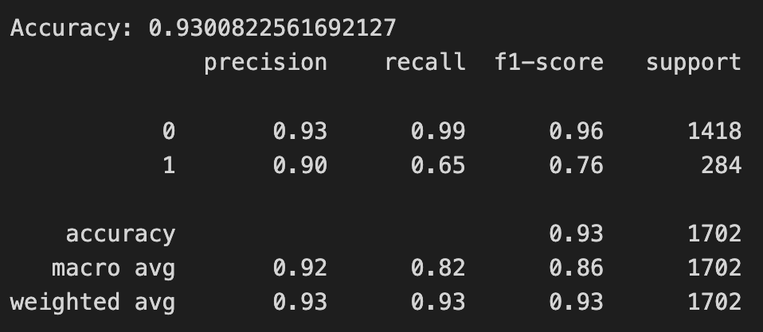
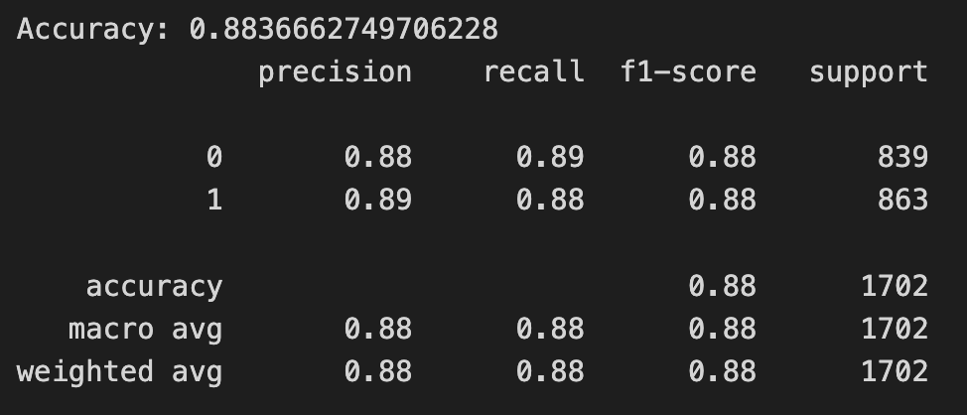
Modeling – 1st Layer Modeling Technique
Random Forest and Artificial Neural Network binary classification
Equal predictive statistics
Adjustments
Initial data leakage due to the nature of the data set
Winner of overall fighter always listed as Fighter 1.
Led to models always predicting fighter 1
Solution: Flipping fighter 1 and fighter 2 on 50% of data points.

Slide 19
Modeling – 1st Layer Modeling Technique
Random Forest and Artificial Neural Network binary classification
Equal predictive statistics
Model Name | Accuracy | Precision | Recall | F1 Score
Random Forest | 88.36% | 0.88 | 0.88 | 0.88
ANN | 88.36% | 0.88 | 0.88 | 0.88

Slide 20
Modeling – 2nd Layer Full fight prediction
Building upon predictions made in layer 1
Predict winner of fight given information readily available beforehand
Goal: Beating the sportsbooks

Slide 21
Modeling – 2nd Layer Model design
Input Data
Output of first layer model (Expected Rounds Score)
Fighters’ general information
Age, weight, height, reach
Fighters’ past performance history
Win/loss, fighting stats

Slide 22
Modeling – 2nd Layer Modeling techniques
Explored various ML models:
Logistic Regression, Random Forest, SVM, ANN, Gradient Boosting
Logistic Regression proved to have highest predictive statistics.
Model Name | Accuracy | Precision | Recall | F1 Score
Random Forest | 59.1% | 0.59 | 0.59 | 0.59
ANN | 59.1% | 0.59 | 0.59 | 0.59
Logistic Regression | 61.0% | 0.60 | 0.60 | 0.60
SVM | 57.12% | 0.57 | 0.49 | 0.53
Gradient Boosting | 55.71% | 0.54 | 0.55 | 0.55

Slide 23
Results

Slide 24
Evaluating model performance
1st layer results:
Accuracy of 88.3%
Baseline (fighter with more significant strikes ): 74.4% accuracy
2nd layer results:
Accuracy of best model (logistic regression): 61.0% accuracy
Baseline/Goal (favorite according to betting odds): 64.3% accuracy

Slide 25
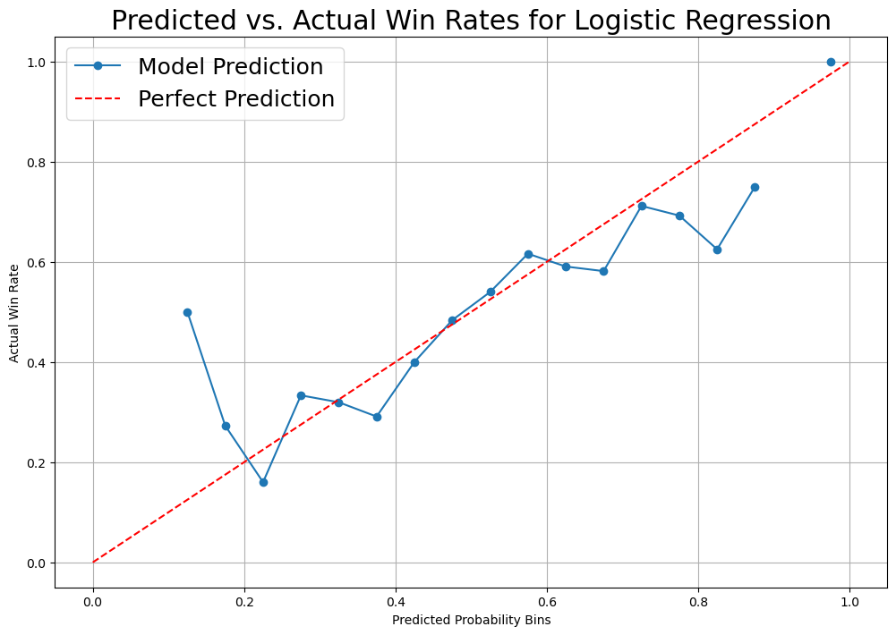
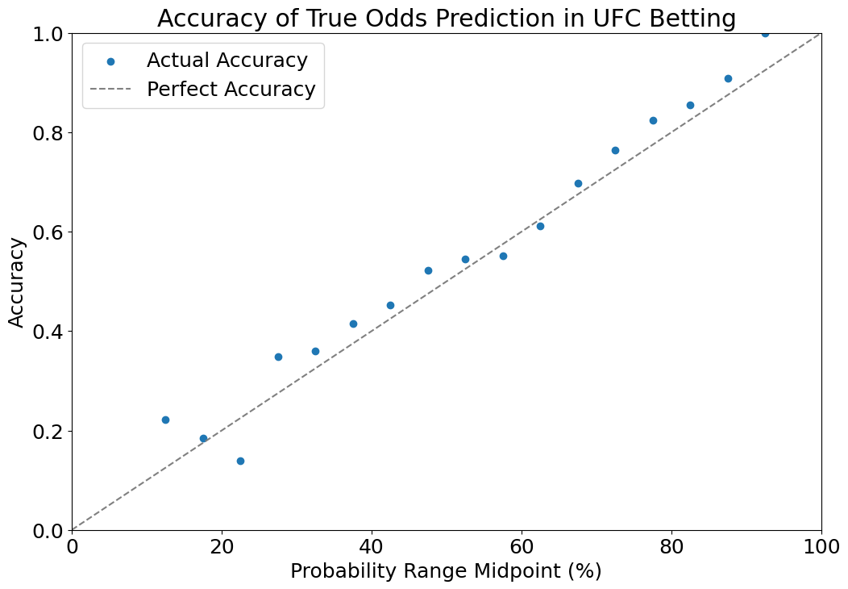
Evaluating Model performance
Sample Size: 1411
Sample Size: 4895

Slide 26
Most important features Layer 1
Total Strikes Landed
Significant Strikes Landed
Head Strikes Landed
Control
Total Strikes Attempted

Slide 27
Most important features Layer 2
Logistic regression
Random forest
Reach
Significant Strikes per Minute
Height
ELO
Win/Lose Streak
Age
ELO
Last 15 Expected Round Average
Significant Strikes per Minute
Reach
Notes:
ELO is a rating system that calculates the relative skill levels of players in zero-sum games, such as chess
Created by Arpad ELO

Slide 28
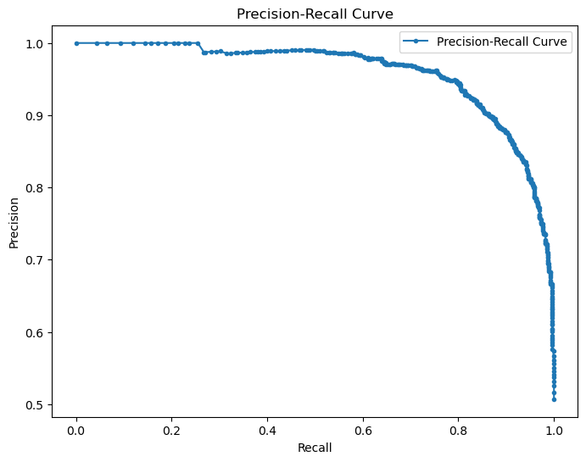
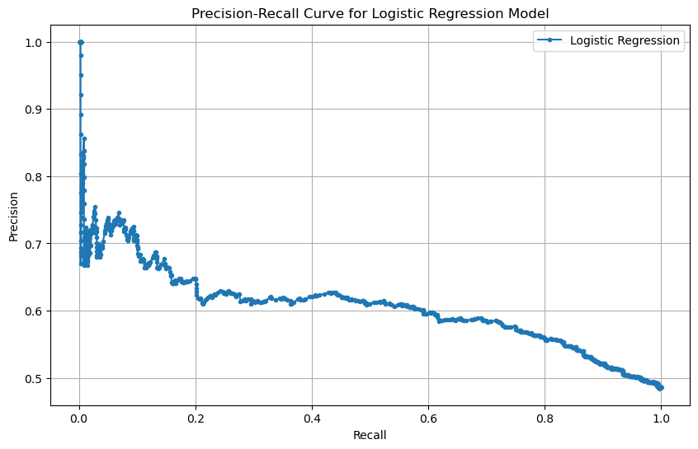
Precision-recall curves
Layer 1 Model
Layer 2 Model
Notes:
Precision is related to a low false positive rate while recall is related to a low false negative rate.
Precision. =True Positive / total positive
Recall = True positive / (TP + FN)
F1 score = Harmonic mean. Combinese both into a single measure that captures both properties From 0-1
2*(P*R/P+R)

Slide 29
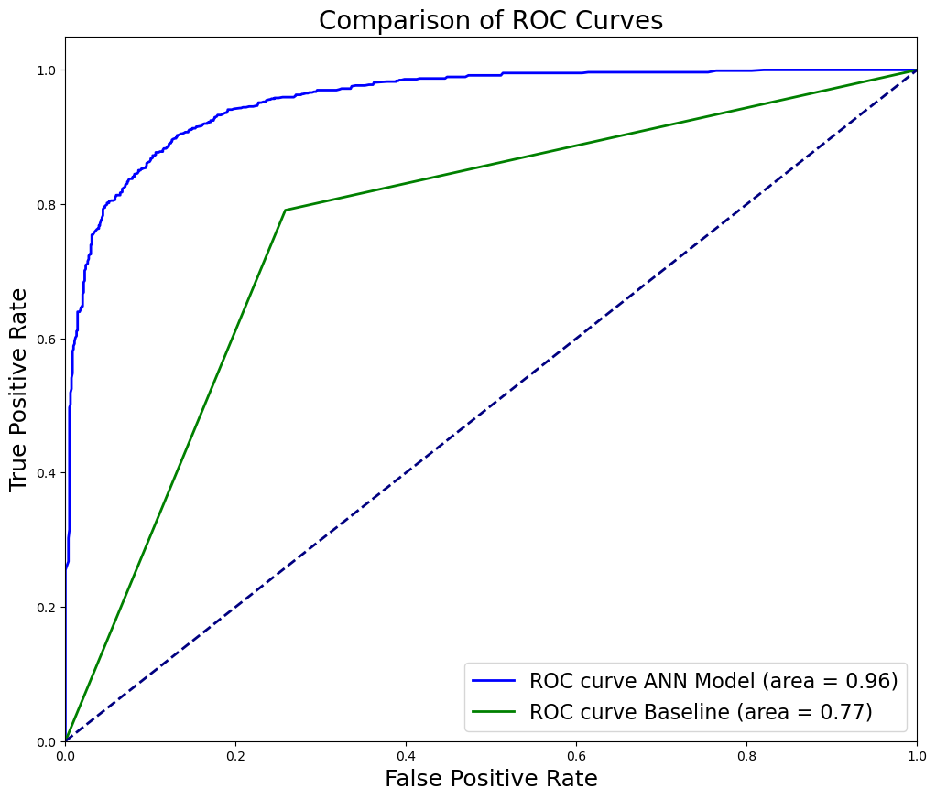
ROC Curve Layer 1

Slide 30
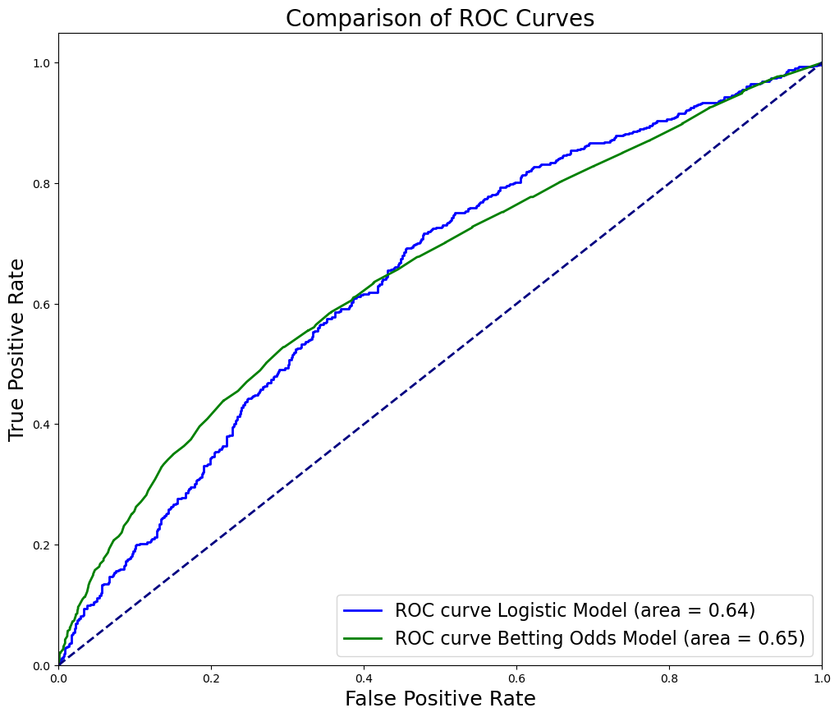
ROC Curve Layer 2

Slide 31
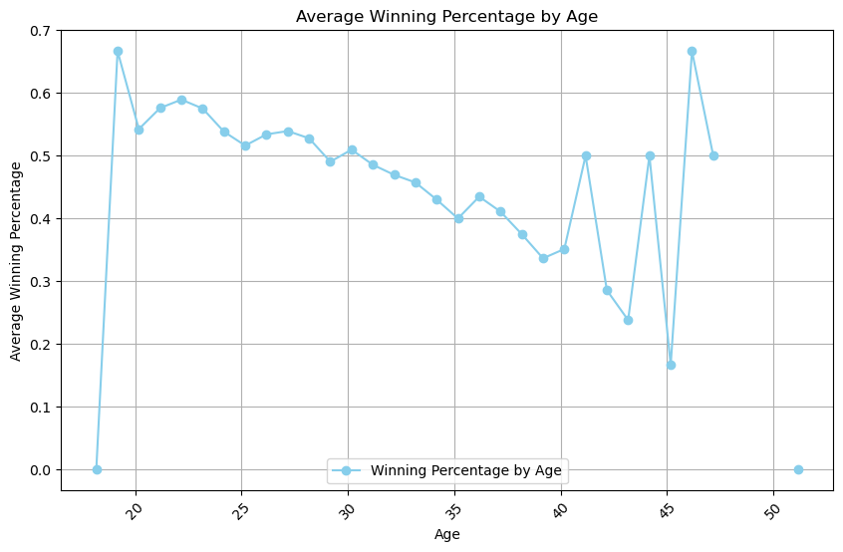
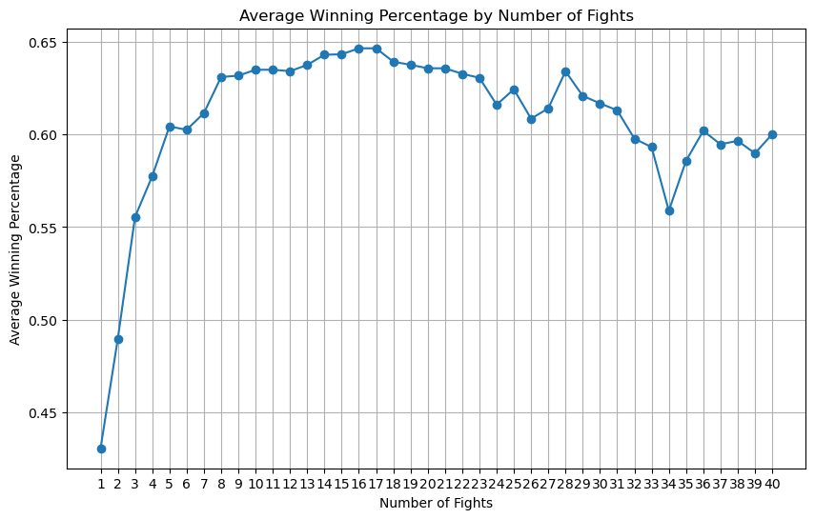

Slide 32
Conclusion

Slide 33
takeaways
First Layer Model – success
Other applications?
Judging Judges
Second Layer Model – needs more work
Perhaps more nuance required
Logistic Regression chose different features
Linear relationships were stronger in the height/win streak features than age/exp. rounds

Slide 34
Future work
Create more features
The ones I have were relatively basic, and not being a full expert in UFC/MMA may have held me back in thinking about which features are correlated / more important in fights
Apply concepts to other sports
Began working on baseball project
Football 4th down decision project in CSE 555T
Notes:
Having a technical understanding of the dynmaics of the sport would help going forwards

Slide 35
Thank you!
Notes:
u

